Slide 1
ECE 313: PROBABILITY WITH ENGINEERING APPLICATIONS
Fall 2023
Prof. Eric Chitambar
Lecture 23

Slide 2
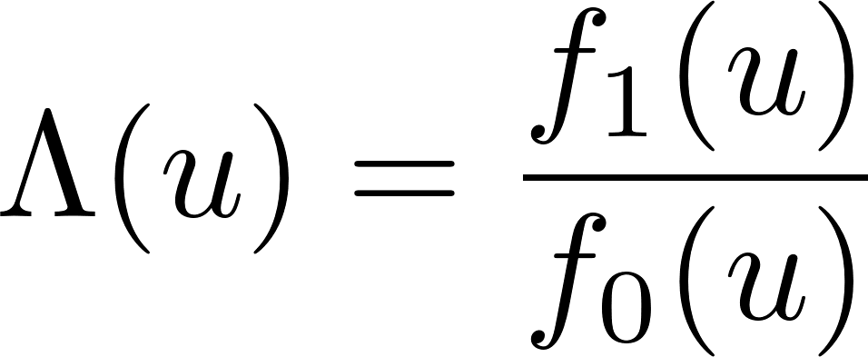
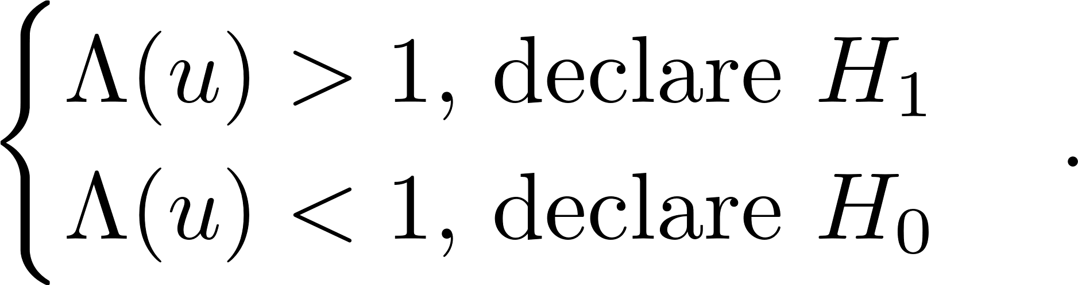
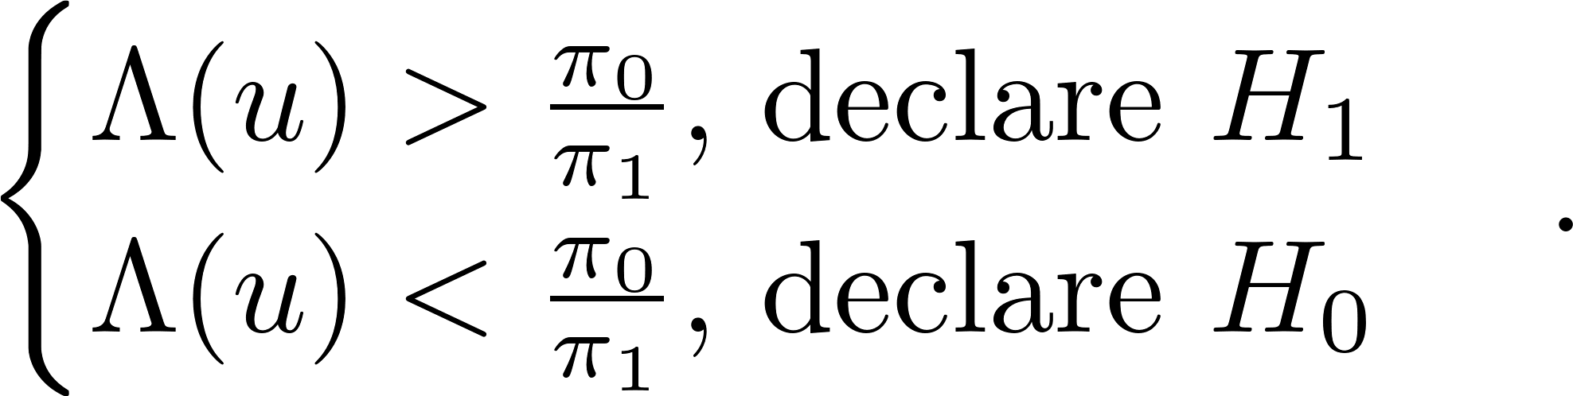

Hypothesis Testing

Slide 3
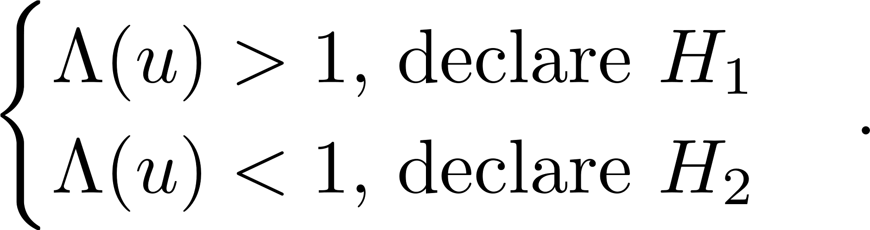

Hypothesis Testing

Slide 4

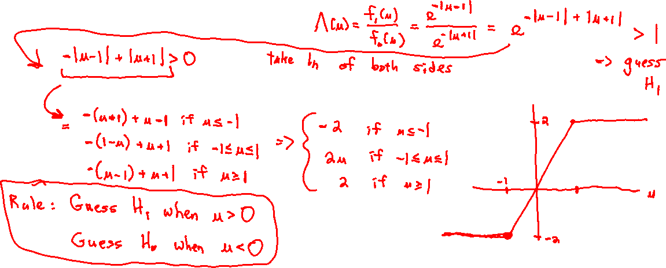
Hypothesis Testing

Slide 5
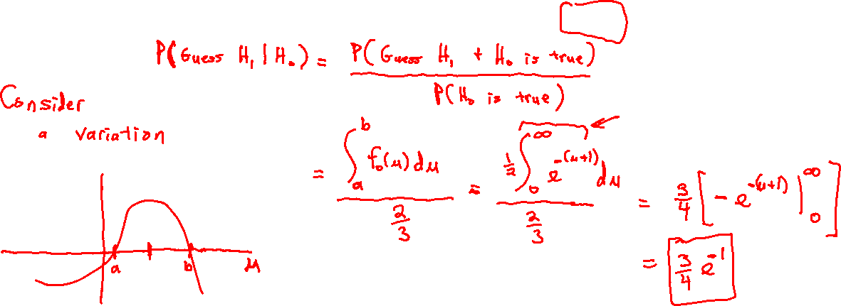
Hypothesis Testing

Slide 6
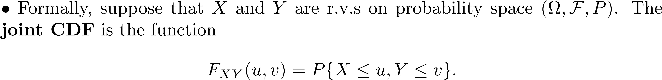
Jointly Distributed Random Variables

Slide 7

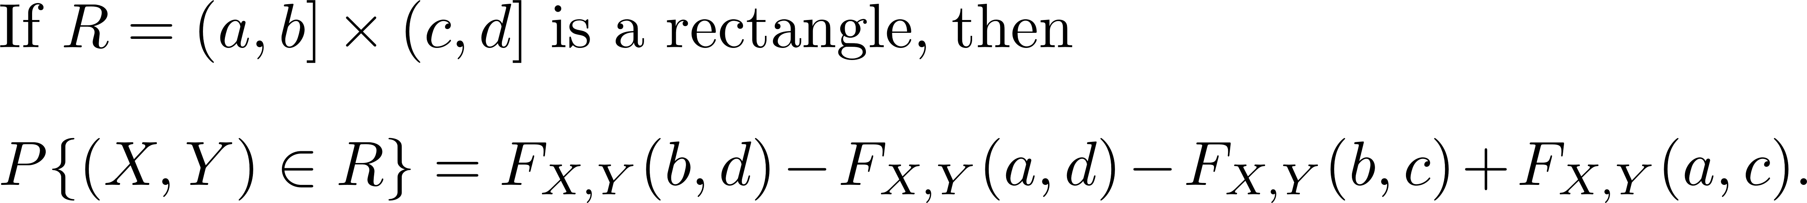




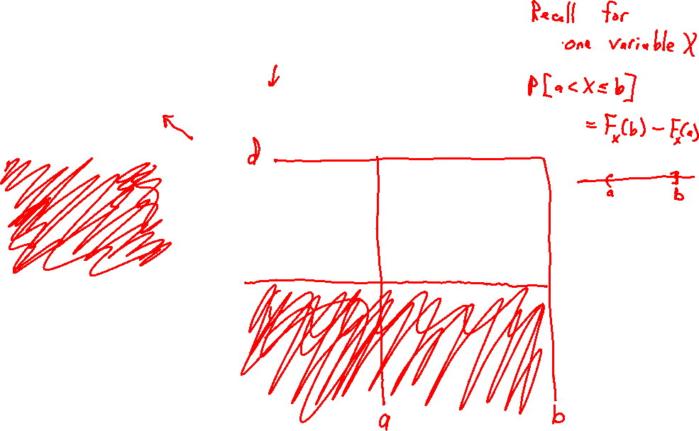
Joint Cumulative Distribution Function

Slide 8

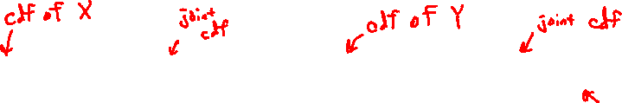
Joint Cumulative Distribution Function

Slide 9
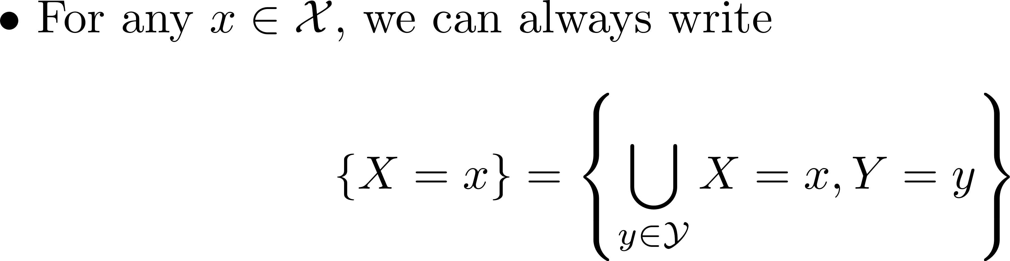
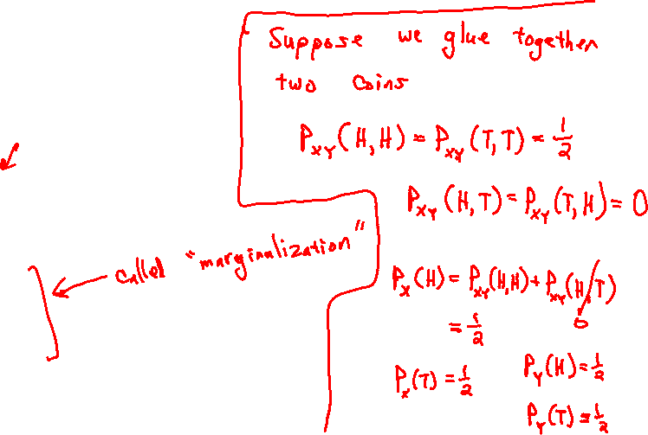
Joint PMF for Discrete R.V.s

Slide 10
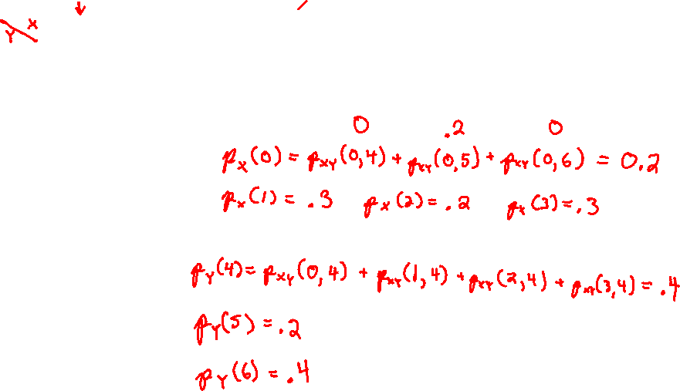
Joint PMF for Discrete R.V.s

Slide 11
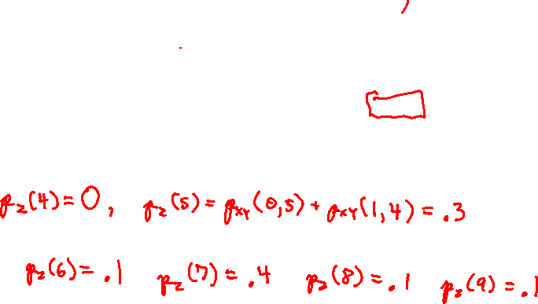
Joint PMF for Discrete R.V.s

Slide 12
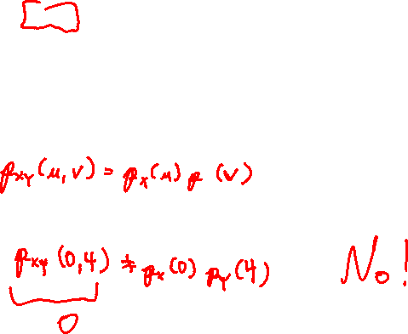
Joint PMF for Discrete R.V.s

Slide 13
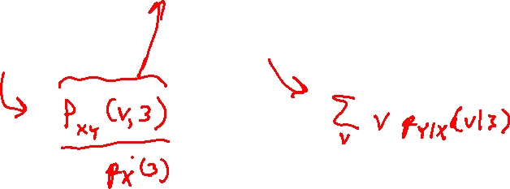
Joint PMF for Discrete R.V.s

